Slide 1
Early Mobilization For Technology-Dependent Children
  Asa Cook, Jerimiah Lorentz, Chimezie Ileje
Notes:
Introductions
Preliminary Presentation
Promote…

Slide 2
Background
Notes:
Terms

Slide 3
Mobilization in Recovery
Physical activity sufficient to elicit acute physiological effects that:
  Enhance ventilation
  Central and peripheral perfusion
  Circulation
  Muscle metabolism
  Alertness
Notes:
Physicians used to encourage rest
Recovery = rest >>> ineffective
Mobilization = quicker and more effective recovery
Mobilization can be defined as:

Slide 4
Benefits of Mobilization
Shortened hospital stays
Fewer ventilator-dependent days
Better functional status upon discharge
Decreased muscle loss
Notes:
In comparison to rest, mobilization…less time in hospital
Avoid muscle loss due to inactivity

Slide 5
Technology-Dependent Children
Common Conditions Include:
  Neuromuscular disease
  Congenital abnormalities of lungs/airways
  Complications from serious injury, illness, or surgery
Equipment
  Gastrostomy and Jejunostomy Tubes
  Ventricular Shunts
  Baclofen Pumps
  Indwelling Central Venous Catheters
  Tracheostomies
Notes:
= children who rely on long-term medical and technical support for physiological function.
Often describes….ventilation machines…
more broadly...cannot physiologically support themself

Slide 6
Need Statement
Mobilize technology-dependent children to support recovery
Lack of child-friendly physical therapy technology
Reduced accuracy of assessment of recovery progress
Notes:
Technology-dependent children ….reasons listed before.
Difficulty assessing progress…not engaging >> inaccurate assessment

Slide 7
Project Scope
We propose to deliver a portable mechanical device that converts a patient’s physical effort into an engaging display for a technology-dependent child and quantifiable data accessible to a clinician. It is essential that children are encouraged to complete the necessary exercises so that their documented progress is accurate. We will deliver a prototype of the device, along with diagrams, user instructions, and other documentation appropriate for reproducing the product, to Dr. Allan Doctor by April 23, 2018.
Notes:
Dr. Allan doctor – client

Slide 8
Design Requirements

Slide 9
Safe for Use
User with limited range of motion
Must accommodate wires, tubes, accessories of medical equipment
Electrically insulated
While in use
  must occupy < 0.5 m³
  Not exceed 1.5 m in any dimension
Notes:
technology-dependent >>> wires, tubes or other equipment….keep these children alive.
Safety concerns are also related to bed dimensions

Slide 10
Support Patient Use
Accessible to user positioned 0 – 45° parallel to ground
Withstand forces applied by users (Human Performance Capabilities)
  Grip force 800 N
  Pedal force 800 N
Notes:
Device also needs to be accessible to the patient
Patients are often lying down
Needs to withstand grip force and pedal force of 800N
US Military Data

Slide 11
Motivate User to Engage in Physical Activity
Attention span rule of thumb: 3 – 5 minutes/year of age (Fort Carson MEDDAC)
Interface engages user for 3*y minutes
Notes:
If you’ve ever worked with children…
Capture their attention = crucial
The most important requirement of our design
Unique
5 year old > 15-25 > 15

Slide 12
Enter and Exit Room Easily
Transportable through 2.03 x 0.91-meter door
Moved with under 120 N of Force (Das and Human Performance Capabilities)
Notes:
In and out
Portable and not difficult to push
Again US military data

Slide 13
Convert Mechanical Effort into Output Desired by User
Record duration and intensity of physical activity
Output based on existing therapy data
Accuracy of calorie counter within 25% (Park)
Notes:
Can’t be too difficult/easy >> discouraging/boring
Adjustable for ability/age
Accuracy of this component based on existing motivator

Slide 14
Provide User Progress
Accessible to physicians, caretakers, and patients
Simple report: images and < 20 words
Detailed report: measurements within 3% error (Poon)
Notes:
Tracking progress = essential for continued engagement
Simple report = patients and caretakers
Detailed = sufficient for clinical use

Slide 15
Simple to Use
Used in home, hospital, or rehab center
Setup time < 5 minutes for first-time user
Notes:
Easy to use in home…
Lofty goal
Never used before

Slide 16
Budget of $1000
Cost of prototype
  User Interface
  Mechanical components
  Computer
Seeking departmental and outside funding

Slide 17
Existing Solutions

Slide 18
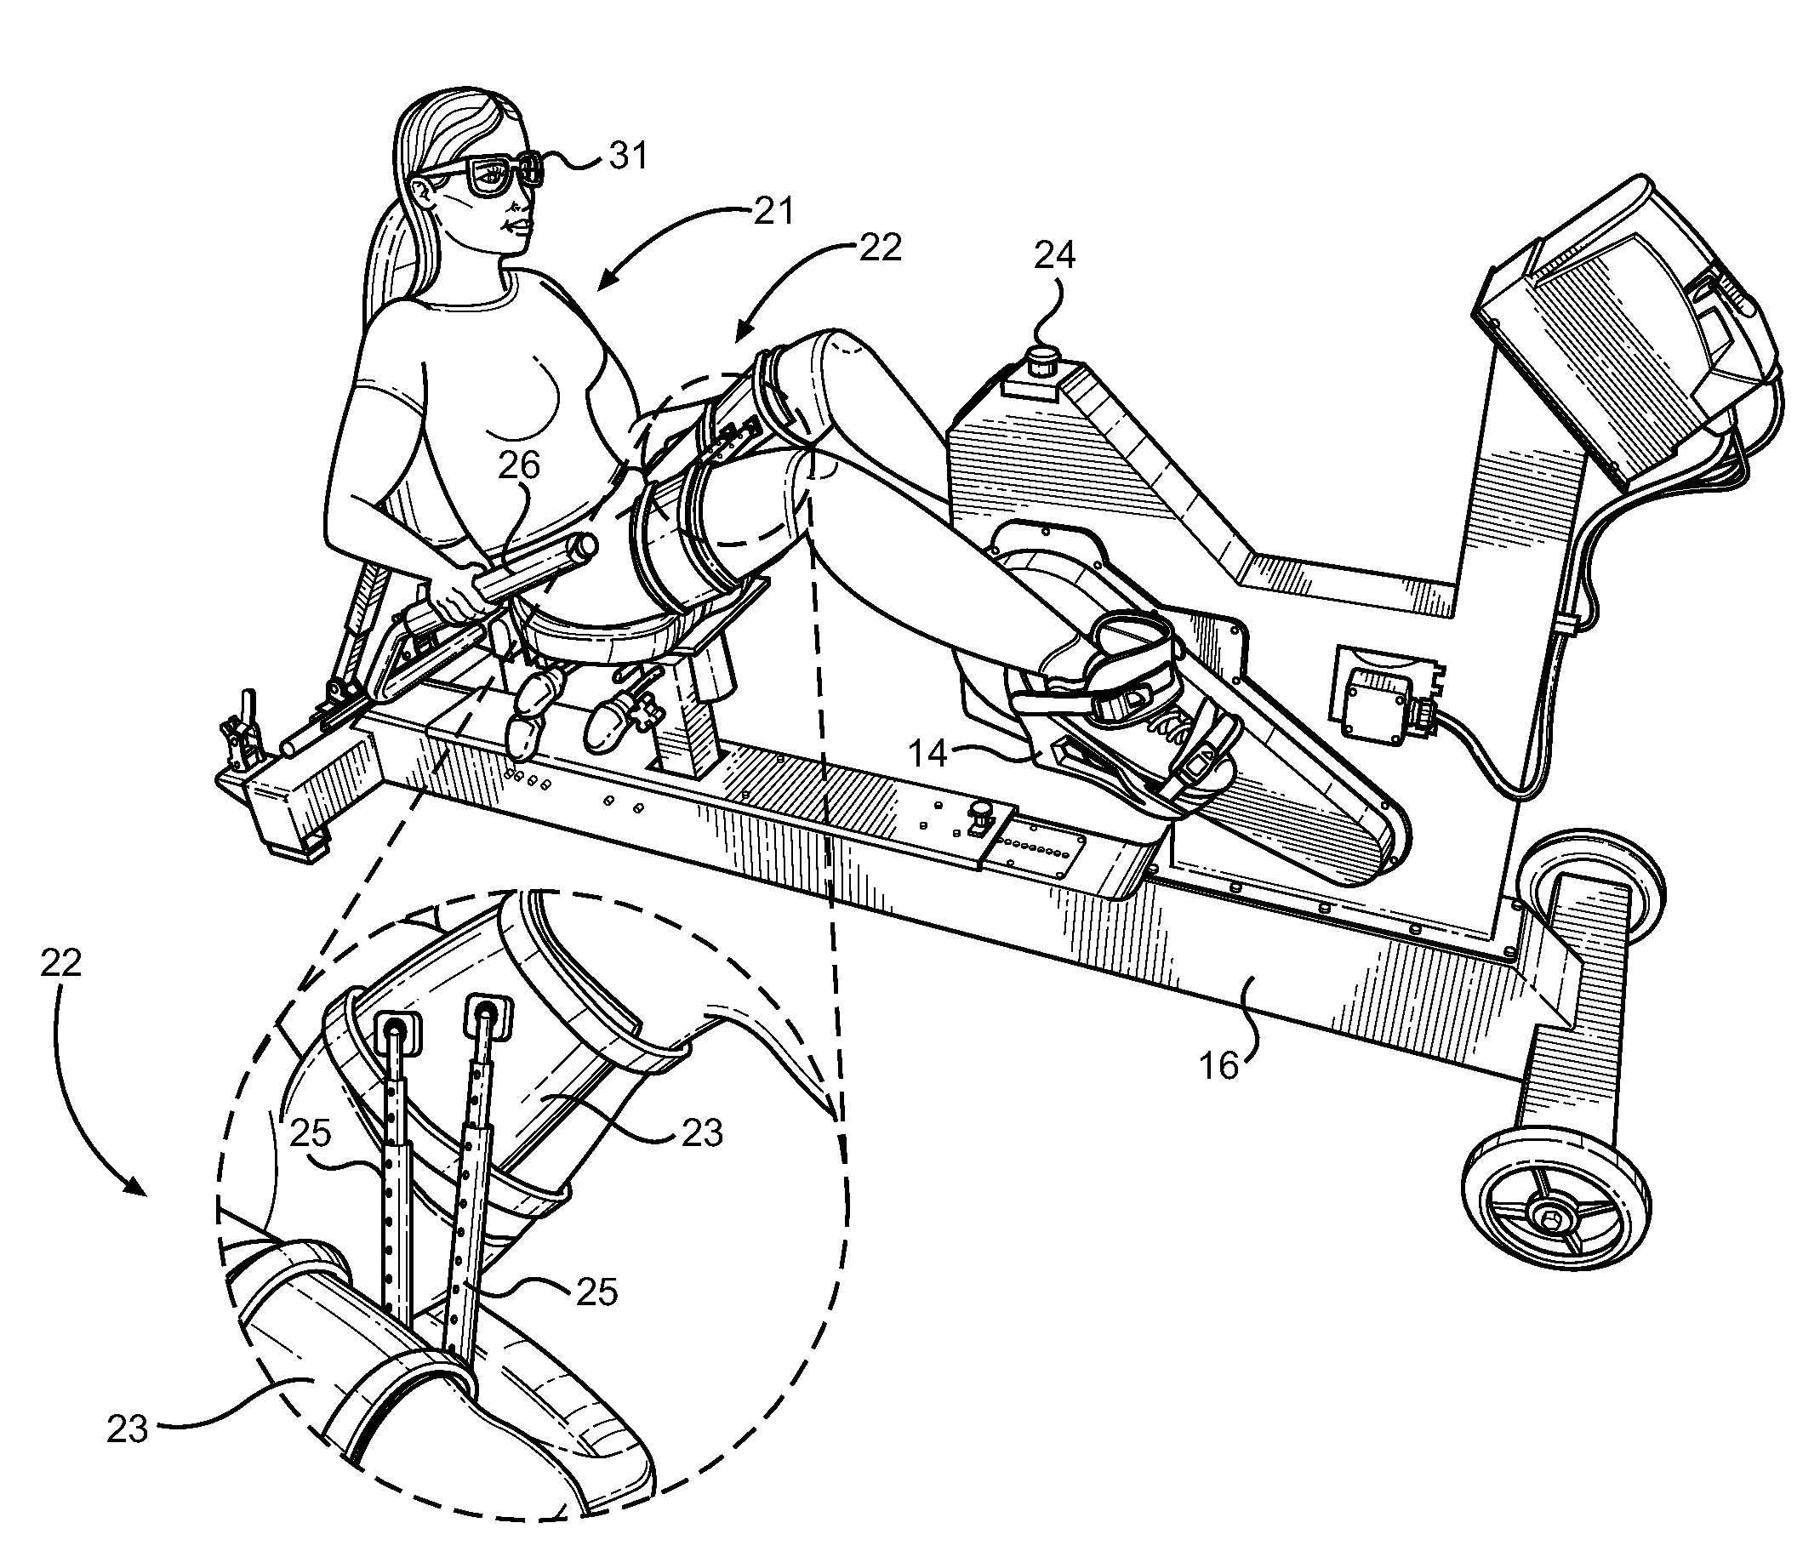
Bouchard Patent
Notes:
Patented in 2012
Exercise Bike
Secured with thigh braces and foot restraint

Slide 19
Bouchard Patent
Pros
Cons
Motive input supplements user input
Visual stimulus distracts user
Increases blood flow
Relieves mental stress
Requires users to be out of bed
Occupies large area
Display not child-friendly
Too large for use by child
Notes:
Motorized >>> don’t have to do physical activity unassisted
Visual stimulus serves as more of a distractor, not a motivator

Slide 20
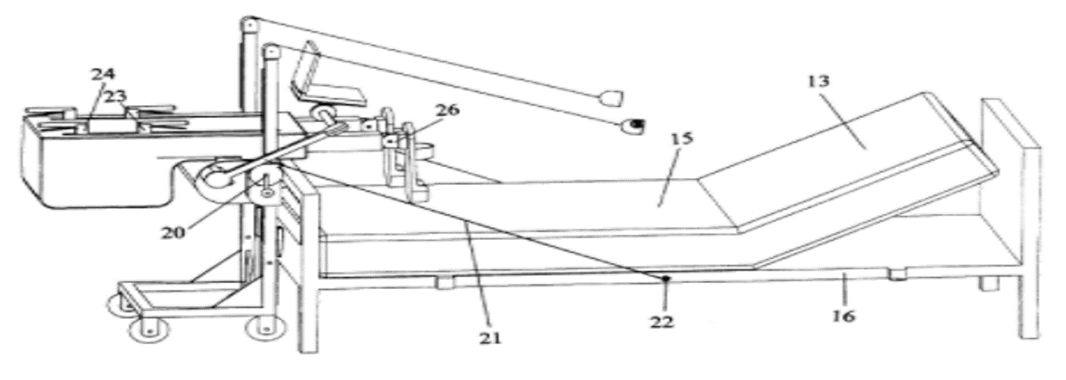
Synergy’s In Bed Exercise Device
Notes:
Patented in 2000
Similar to stair machine; exert force on lever with feet

Slide 21
Synergy’s In Bed Exercise Device
Pros
Cons
Portable
Easily attaches to foot of hospital bed
Strengthens muscle groups used in performing normal activities
Records data on user’s force output
Lacks visual display
Not targeted towards children
Notes:
Wheeled to foot of bed
Strengthens certain muscle groups to encourage mobilization
Only prints force output, no visual display

Slide 22
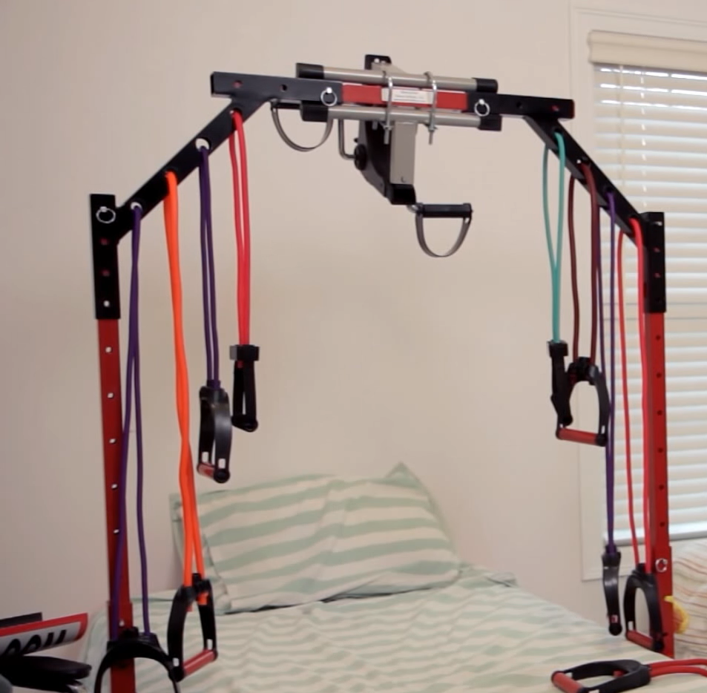
Stuck in Bed Fitness Solutions
Notes:
Patented in 2016
Resistance bands
Mounts to both sides of bed frame

Slide 23
Stuck in Bed Fitness Solutions
Pros
Cons
Able to engage entire body
Designed for rehabilitation
Accessible to individual laying in bed
Lacks interactive interface/display
Relies solely on user input
Not child-friendly

Slide 24
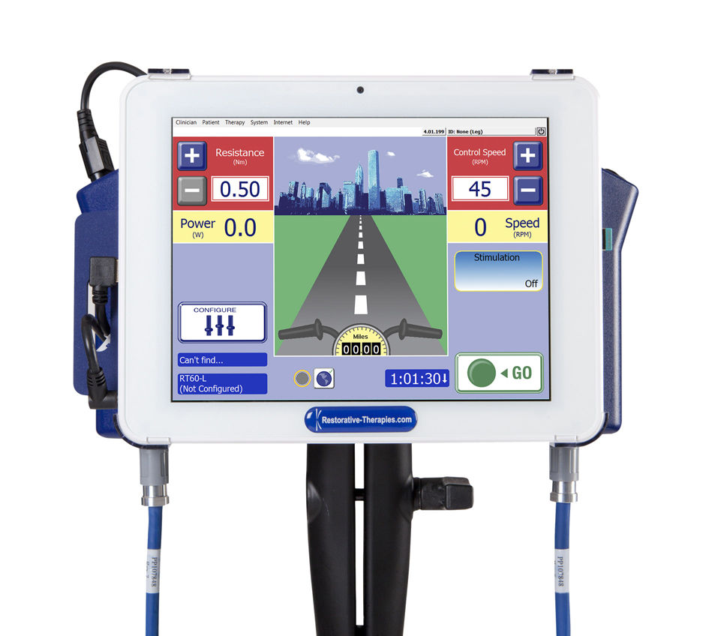
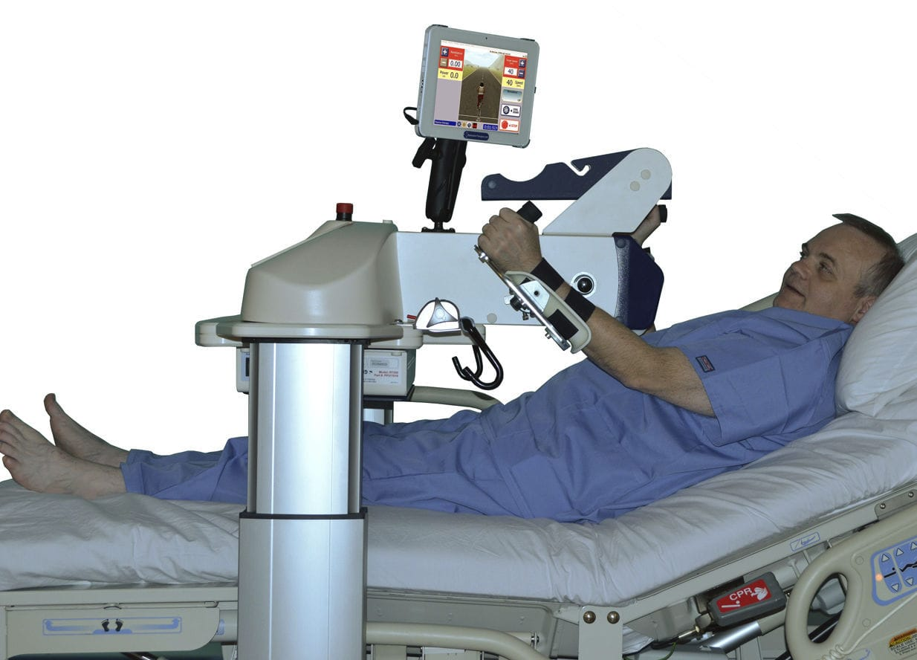
RT300 Supine
Notes:
Closest to fulfilling our need
Two modes
Includes a visual display of biker
Somewhat engaging

Slide 25
RT300 Supine
Pros
Cons
Reclined user can operate with arms/legs
Interactive visual display of biker
Adjustable height
Wheels allow for easy transport
Display not child-friendly
Completely surrounds bed
Large
Notes:
Display gives more than just numbers or graphs, but not enough

Slide 26
Our Design Team

Slide 27

Asa Cook
Graphic Design
Funding Manager
Website Creation and Management
Literature Review (Background)

Slide 28
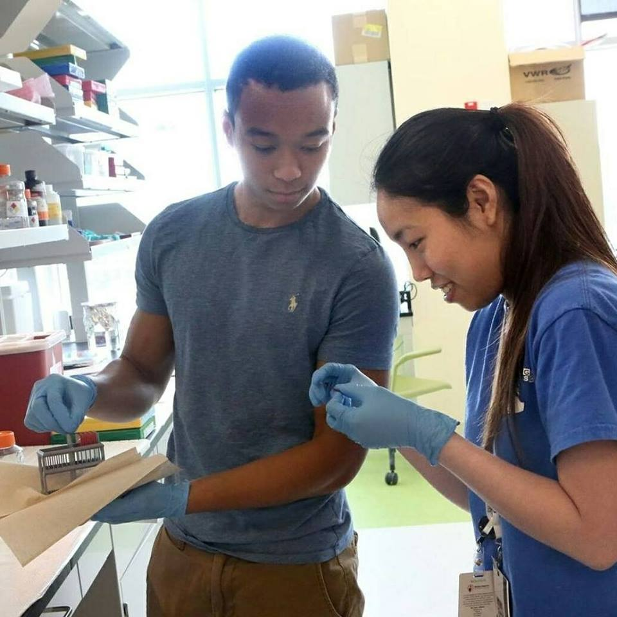
Jerimiah Lorentz
Software Development
Literature Review (Existing Solutions)
Website Management

Slide 29

Chimezie Ileje
Hardware Development
CAD Design
Literature Review (Specs)
Website Management

Slide 30
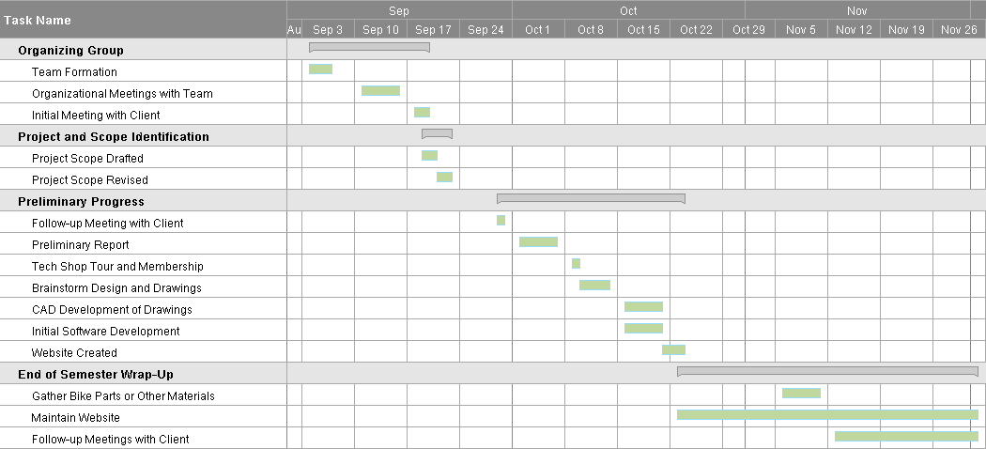
Design Schedule
Notes:
Deliver prototype by end of year
Work diligently this semester
tech shop tour and membership
CAD
Website Creation
meetings with client throughout semester every other week

Slide 31
Sources
Barriskill, Andrew Bruce, Scott Simcox, Robert Flesher, and Susan Harkema. Supine Cycle. Restorative Therapies, Inc., assignee. Patent US 9511256 B2. 6 Dec. 2016. Web.
Bouchard, Marc, and Lizbeth Bouchard. Motorized Lower Body Rehabilitation Device and Method. Marc Bouchard and Lizbeth Bouchard, assignee. Patent US 20120329611 A1. 6 Dec. 2016. Web.
Cameron, Saoirse, et al. “Early Mobilization in the Critical Care Unit: A Review of Adult and Pediatric Literature.” Journal of Critical Care, vol. 30, no. 4, 2015, pp. 664–672., doi:10.1016/j.jcrc.2015.03.032.
Das, Biman. Advances in Human Strength Measurement and Modeling in Workspace. Advances in Physical Ergonomics and Human Factors: Part I, AHFE Conference, 2014, p. 293.
Fort Carson MEDDAC. Attention Deficit Disorder (Short Attention Span). Attention Deficit Disorder (Short Attention Span), 2000.
National Aeronautics and Space Administration. “Human Performance Capabilities.” NASA, NASA, 7 May 2008, msis.jsc.nasa.gov/sections/section04.htm.
Poon, Leonard W. “Active Living, Cognitive Functioning, and Aging.” Active Living, Cognitive Functioning, and Aging, Human Kinetics, 2009, p. 100.
Society of Hospital Medicine. “Technology Dependent Children.” Journal of Hospital Medicine, vol. 5, no. S2, 8 Apr. 2010, p. 80.
Notes:
The end. Questions?

