Slide 1
Early Mobilization For Technology-Dependent Children
Asa Cook, Jerimiah Lorentz, Chimezie Ileje
Client: Dr. Allan Doctor
Notes:
Introductions
Preliminary Presentation
Promote…

Slide 2
Progress Report Outline
Overview of Project
Changes to Need Statement and Project Scope
Highlighted Design Specifications
Highlighted Design Alternatives
Pugh Chart Analysis and Chosen Solution
Budget
Notes:
Physicians used to encourage rest
Recovery = rest >>> ineffective
Mobilization = quicker and more effective recovery
Mobilization can be defined as:

Slide 3
Overview
Notes:
Terms

Slide 4
Our Project aims to:
develop a mobilization device for technology-dependent children who are confined to bed rest due to complex surgeries, severe illness, or physical or neurological disabilities
Provide both a mechanical device that enables technology-dependent children to mobilize and an interface that converts their physical force into a display
Notes:
In comparison to rest, mobilization…less time in hospital
Avoid muscle loss due to inactivity

Slide 5
Mobilization in Recovery
Mobilization decreases risk of ICU-Acquired Weakness
ICU-Acquired Weakness is associated with:
Longer ICU length of stay
More mechanical ventilation days
Poor discharge position
Notes:
Physicians used to encourage rest
Recovery = rest >>> ineffective
Mobilization = quicker and more effective recovery
Mobilization can be defined as:

Slide 6
Revisions

Slide 7
Changes From Preliminary Report
“Creating an engaging interface for patients”
We promised to engage any child, regardless of neurological or physical limitations
We now aim to convert physical input force into a display with the duration of each patient’s exercise recorded
Rehabilitation vs. Healing
Mobilization will not be aimed at rehabilitating technology-dependent children
Our aim is to increase anabolic state – promote a generalized state of healing
Notes:
Technology-dependent children ….reasons listed before.
Difficulty assessing progress…not engaging >> inaccurate assessment

Slide 8
Project Scope
We propose to deliver a portable mechanical device that converts a patient’s physical effort into an engaging display for a technology-dependent child and quantifiable data accessible to a clinician. It is essential that children are encouraged to complete the necessary exercises so that their documented progress is accurate. We will deliver a prototype of the device, along with diagrams, user instructions, and other documentation appropriate for reproducing the product, to Dr. Allan Doctor by April 23, 2018.
Notes:
Dr. Allan doctor – client

Slide 9
Project Scope
We propose to deliver a portable mechanical device that converts a patient’s physical effort into a display for a technology-dependent child and quantifiable data accessible to a clinician. It is essential that children are encouraged to complete the necessary exercises so that their documented progress is accurate. We will deliver a prototype of the device, along with diagrams, user instructions, and other documentation appropriate for reproducing the product, to Dr. Allan Doctor by April 23, 2018.
Notes:
Dr. Allan doctor – client

Slide 10
Project Scope
We propose to deliver a portable mechanical device that converts a patient’s physical effort into a display for a technology-dependent child and quantifiable data accessible to a clinician, including exercise duration, cadence, and force. We will deliver a prototype of the device, along with diagrams, user instructions, and other documentation appropriate for reproducing the product, to Dr. Allan Doctor by April 23, 2018.
Notes:
Dr. Allan doctor – client

Slide 11
Design specifications

Slide 12
Mechanical Component Design Specifications
Design Specification | Metric | Pugh Chart Importance Rating
Product Dimensions | (l x w x h) < 0.5 m³; l, w, and h < 2 m (while in use) | 6
Cost of Materials | < $100 | 2
Setup Steps | ≤ 5 steps | 2
Assist in Upper and Lower Body Exercise | Both | 4
Adjustable Dimensions | Yes | 9
Adjustable Resistance | Yes | 9
Risk to Patient | Safety Rating | 10

Slide 13
Interface Component Design Specifications
Design Specification | Metric | Pugh Chart Importance Rating
Product Dimensions | (l x w x h) < .5 m3; l,w, and h < 2 m (in use) | 6
Cost of Materials | < $100 | 2
Setup Steps | ≤ 5 steps | 2
Audio and Visual | Both | 8
Responsive to Changes in User Input | Yes | 10
Risk to Patient | Safety rating | 19

Slide 14
Design Specifications Excluded from the Pugh Chart
Recording Specifications: duration, cadence, and power must be recorded
Reporting Specifications: report should use both images and words
Portability: medical professionals should be able to transport the device into and out of a room with a standard-sized door (2.03 x 0.91 meters)

Slide 15
Design alternatives and Pugh analysis

Slide 16
Mechanical Device Brainstorming
Horizontal Rowing Machine
Tilted Board
Bicycle Machine
Step Machine
Wheel Machine
Vertical Rowing Machine
Clamp-to-Bed Pulleys
Body Bands
Push-up Machine

Slide 17
Solutions Ranked on a Scale from 0-10 with 0 being a poor solution and 10 being an ideal solution

Slide 18
Solutions Ranked on a Scale from 0-10 with 0 being a poor solution and 10 being an ideal solution

Slide 19
Solutions Ranked on a Scale from 0-10 with 0 being a poor solution and 10 being an ideal solution

Slide 20
Solutions Ranked on a Scale from 0-10 with 0 being a poor solution and 10 being an ideal solution

Slide 21
Solutions Ranked on a Scale from 0-10 with 0 being a poor solution and 10 being an ideal solution

Slide 22
Bicycle Machine
Overview:
The bicycle machine design resembles that of a pedal mechanism on an exercise bike. The device will use an articulating arm with a locking mechanism to allow the user access to the pedals. Design requires a mechanical flywheel connected to the user operated pedals. The flywheel design uses a flywheel to adjust the pedal resistance. Users are tasked with rotating the pedals with their hands or feet for specified duration.
Characteristics:
Adjustable resistance
Adjustable dimensions
Modifiable to target either the upper or lower body muscles
High cost (>$300)
High device adaptability
5-6 setup steps
Easily moved out of the way
Resembles a common exercise
Moderate isk for malfunction based injury

Slide 23
Tilted Board Machine
Overview:
The titled board design resembles that of a directional pad on a video game controller. The device will use an articulating arm with a locking mechanism to allow the user access. Articulating arm connects to the middle of a rectangular board that the user will initially hold parallel to their chest, arms bent halfway. User will then be instructed to push with one arm and pull with the other causing the board to tilt. Device can also be modified to target the users lower body.
Characteristics:
Adjustable resistance
Adjustable dimensions
Modifiable to target either the upper or lower body muscles
Under budget (<$300)
High device adaptability
4-5 setup steps
Easily moved out of the way
Minimal risk to malfunction based injury
Wide variety of paired game

Slide 24
Interface Brainstorming
Goggles
Computer Monitor
Laser Projector
Musical Light Show
MP3 Player
Turning the TV on

Slide 25
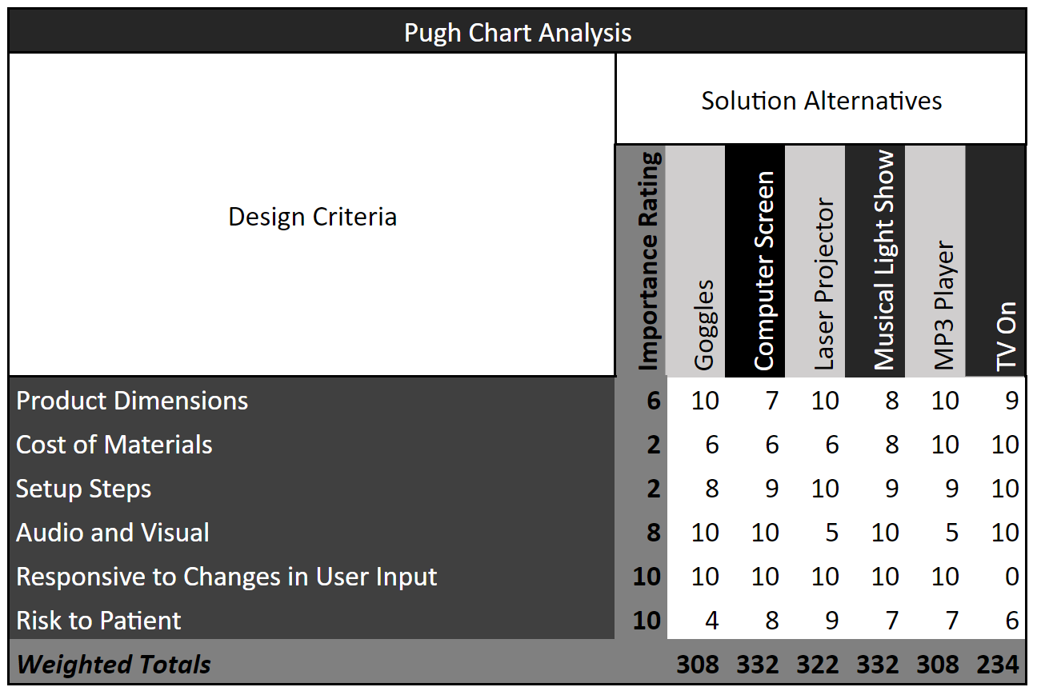
Solutions Ranked on a Scale from 0-10 with 0 being a poor solution and 10 being an ideal solution

Slide 26
Solutions Ranked on a Scale from 0-10 with 0 being a poor solution and 10 being an ideal solution

Slide 27
Solutions Ranked on a Scale from 0-10 with 0 being a poor solution and 10 being an ideal solution

Slide 28
Computer Monitor
Overview:
The interface consists of a computer monitor that visually displays a game run by a Raspberry PI (arduino). The game would be created so that it relates to the actual exercise performed by the patient.
Characteristics:
Visual and Audio
Adaptability in gaming display
High cost
5-6 setup steps
Easily moved out of the way
Very little risk to patient

Slide 29
Musical Light Show
Overview:
Design incorporates a Raspberry Pi, LED light board, and a SSR module board to display a musical light show to a user. The device responds to changes in user input by changing speed of music played and colors of lights displayed.
Characteristics:
Audio and Visual
Low cost
Very little adaptability based on exercise performed
4-5 setup steps
Easily moved out of the way
Bright, rapid lights present risk to injury

Slide 30
Chosen Solution
Notes:
Final slide showing chosen solution

Slide 31
We aim to develop a solution with:
A Tilted Board Exercise Machine
and
A Computer Monitor Interface

Slide 32
Picking the Tilted Board over the Bicycle Machine
Cost (Importance Rating = 2): the Bicycle Machine is slightly more expensive because of the need for two different kinds of pedals
Setup Steps (Importance Rating = 2): the Bicycle Machine has a longer setup time because the both the pedals and pedal arms can be exchanged.
Risk to Patient (Importance Rating = 10): the Bicycle Machine has the added risk of injury because of the pedals can continue to rotate after the user stops actively participating (medium malfunction injury rating). The Tilted Board Machine immediately stops after discontinuation, so the device receives a low malfunction injury rating.

Slide 33
Picking the Computer Monitor over the Musical Light Show
Risk to Patient (Importance Rating = 10): the Musical Light show could provide complications for children who have certain neurological or developmental limitations. It may not be safe for every child to be exposed to rapid, bright-shining lights
Contact with Software Developers at Butterscotch Shenanigans provided by our client, Dr. Doctor.

Slide 34
Budget

Slide 35
 | Quantity | Cost | Source
Mechanical Device Materials
Articulating Arm | 1 | $21.00 | Amazon
Wheels (for transporting articulating arm) | 4 | $22.00 (for all 4) | Amazon
Board | 1 | $27.00 | Amazon
Flywheel | 1 | $30.00 | SearsParts Direct
Friction Brake | 1 | $16.00 | Amazon
Interface Materials
Computer Monitor | 1 | $60.00 | Ebay
Arduino | 1 | $35.00 | Amazon
Raspberry Pi | 1 | $25.00 | Amazon
Force sensors | 2 | $21.00 (for both) | Sparkfun
Stand (for computer monitor) | 1 | $35.00 | Amazon
Notes:
Deliver prototype by end of year
Work diligently this semester
tech shop tour and membership
CAD
Website Creation
meetings with client throughout semester every other week

Slide 36
 | Quantity | Cost | Source
Mechanical Device Materials
Articulating Arm | 1 | $21.00 | Amazon
Wheels (for transporting articulating arm) | 4 | $22.00 (for all 4) | Amazon
Board | 1 | $27.00 | Amazon
Flywheel | 1 | $30.00 | SearsParts Direct
Friction Brake | 1 | $16.00 | Amazon
Interface Materials
Computer Monitor | 1 | $60.00 | Ebay
Arduino | 1 | $35.00 | Amazon
Raspberry Pi | 1 | $25.00 | Amazon
Force sensors | 2 | $21.00 (for both) | Sparkfun
Stand (for computer monitor) | 1 | $35.00 | Amazon
Notes:
Deliver prototype by end of year
Work diligently this semester
tech shop tour and membership
CAD
Website Creation
meetings with client throughout semester every other week

Slide 37
 | Quantity | Cost | Source
Mechanical Device Materials
Articulating Arm | 1 | $21.00 | Amazon
Wheels (for transporting articulating arm) | 4 | $22.00 (for all 4) | Amazon
Board | 1 | $27.00 | Amazon
Flywheel | 1 | $30.00 | SearsParts Direct
Friction Brake | 1 | $16.00 | Amazon
Interface Materials
Computer Monitor | 1 | $60.00 | Ebay
Arduino | 1 | $35.00 | Amazon
Raspberry Pi | 1 | $25.00 | Amazon
Force sensors | 2 | $21.00 (for both) | Sparkfun
Stand (for computer monitor) | 1 | $35.00 | Amazon
Notes:
Deliver prototype by end of year
Work diligently this semester
tech shop tour and membership
CAD
Website Creation
meetings with client throughout semester every other week

Slide 38
 | Quantity | Cost | Source
Mechanical Device Materials
Articulating Arm | 1 | $21.00 | Amazon
Wheels (for transporting articulating arm) | 4 | $22.00 (for all 4) | Amazon
Board | 1 | $27.00 | Amazon
Flywheel | 1 | $30.00 | SearsParts Direct
Friction Brake | 1 | $16.00 | Amazon
Interface Materials
Computer Monitor | 1 | $60.00 | Ebay
Arduino | 1 | $35.00 | Amazon
Raspberry Pi | 1 | $25.00 | Amazon
Force sensors | 2 | $21.00 (for both) | Sparkfun
Stand (for computer monitor) | 1 | $35.00 | Amazon
Notes:
Deliver prototype by end of year
Work diligently this semester
tech shop tour and membership
CAD
Website Creation
meetings with client throughout semester every other week

Slide 39
 | Quantity | Cost | Source
Mechanical Device Materials
Articulating Arm | 1 | $21.00 | Amazon
Wheels (for transporting articulating arm) | 4 | $22.00 (for all 4) | Amazon
Board | 1 | $27.00 | Amazon
Flywheel | 1 | $30.00 | SearsParts Direct
Friction Brake | 1 | $16.00 | Amazon
Interface Materials
Computer Monitor | 1 | $60.00 | Ebay
Arduino | 1 | $35.00 | Amazon
Raspberry Pi | 1 | $25.00 | Amazon
Force sensors | 2 | $21.00 (for both) | Sparkfun
Stand (for computer monitor) | 1 | $35.00 | Amazon
Notes:
Deliver prototype by end of year
Work diligently this semester
tech shop tour and membership
CAD
Website Creation
meetings with client throughout semester every other week

Slide 40
 | Quantity | Cost | Source
Mechanical Device Materials
Articulating Arm | 1 | $21.00 | Amazon
Wheels (for transporting articulating arm) | 4 | $22.00 (for all 4) | Amazon
Board | 1 | $27.00 | Amazon
Flywheel | 1 | $30.00 | SearsParts Direct
Friction Brake | 1 | $16.00 | Amazon
Interface Materials
Computer Monitor | 1 | $60.00 | Ebay
Arduino | 1 | $35.00 | Amazon
Raspberry Pi | 1 | $25.00 | Amazon
Force sensors | 2 | $21.00 (for both) | Sparkfun
Stand (for computer monitor) | 1 | $35.00 | Amazon
Notes:
Deliver prototype by end of year
Work diligently this semester
tech shop tour and membership
CAD
Website Creation
meetings with client throughout semester every other week

Slide 41
 | Quantity | Cost | Source
Mechanical Device Materials
Articulating Arm | 1 | $21.00 | Amazon
Wheels (for transporting articulating arm) | 4 | $22.00 (for all 4) | Amazon
Board | 1 | $27.00 | Amazon
Flywheel | 1 | $30.00 | SearsParts Direct
Friction Brake | 1 | $16.00 | Amazon
Interface Materials
Computer Monitor | 1 | $60.00 | Ebay
Arduino | 1 | $35.00 | Amazon
Raspberry Pi | 1 | $25.00 | Amazon
Force sensors | 2 | $21.00 (for both) | Sparkfun
Stand (for computer monitor) | 1 | $35.00 | Amazon
Less than original budget of $300
Notes:
Deliver prototype by end of year
Work diligently this semester
tech shop tour and membership
CAD
Website Creation
meetings with client throughout semester every other week

Slide 42
Sources
Augustsson, Jesper, et al. "Effect of pre-exhaustion exercise on lower-extremity muscle activation during a leg press exercise." The Journal of Strength & Conditioning Research: 17.2 (2003): 411-416.
DeltaFlo Instructables. “Arduino Laser Show With Real Galvos.” Instructables.com, Instructables, 24 Sept. 2017.
Field-Ridley, Aida, et al. “ICU-Acquired Weakness Is Associated With Differences in Clinical Outcomes in Critically Ill Children*.” Pediatric Critical Care Medicine, vol. 17, no. 1, 2016, pp. 53–57.
Lehman, Gregory J., et al. "Variations in muscle activation levels during traditional latissimus dorsi weight training exercises: An experimental study." Dynamic Medicine 3.1 (2004): 4.
Lull, Andrew P. "Exercise bicycle with mechanical flywheel brake." U.S. Patent No. 8,834,324. 16 Sep. 2014.
Maresh, Joseph D. "Roto stepper exercise machine." U.S. Patent No. 5,595,554. 21 Jan. 1997.
Mason, Betsy. “Virtual Reality Has a Motion Sickness Problem.” Science News, Society for Science and the Public, 8 Mar. 2017.
Notes:
The end. Questions?

Slide 43
Sources (cont’d.)
Petrucci, N. “Exposure of the Critically Ill Patient to Extremely Low-Frequency Electromagnetic Fields in the Intensive Care Environment.” Intensive Care Medicine, vol. 25, no. 8, 1999, pp. 847–851., doi:10.1007/s001340050963.
Redfield, Rob, and M. L. Hull. "Prediction of pedal forces in bicycling using optimization methods." Journal of biomechanics 19.7 (1986): 523-540.
Santos, Gilmar M., et al. "Mechanical evaluation of the resistance of elastic bands." Brazilian Journal of Physical Therapy 13.6 (2009): 521-526.
Silva, Anderson. “Create Your Own Musical Light Show with Raspberry Pi.” Opensource.com, Red Hat, 19 Mar. 2015.
Taito, Shunsuke, et al. “Early Mobilization of Mechanically Ventilated Patients in the Intensive Care Unit.”Journal of Intensive Care, vol. 4, no. 1, 2016.
Wang, K.-W. K. and Barnard, A. (2004), Technology-dependent children and their families: a review. Journal of Advanced Nursing, 45: 36 - 46.
Worrell, Teddy W., Elizabeth Crisp, and Christopher LaRosa. "Electromyographic reliability and analysis of selected lower extremity muscles during lateral step-up conditions." Journal of athletic training 33.2 (1998): 156.

Slide 44
Thank you!

