Slide 1
Arkine: A Bedside Exercise Device for Technology Dependent Children
Jeremiah Lorentz, Chimezie Ileje, Asa Cook
Client: Dr. Allan Doctor
Notes:
Good morning…
Dr. Doctor: St. Louis Children’s Hospital
Identified a need for an bedside exercise device for tech dependent children

Slide 2
Validation and Verification Report Outline
Overview of Project
Changes from Progress Report
Verification Plan
Proof of Concept
Future Directions and Overall Status

Slide 3
Project Overview

Slide 4
Project Goals
Develop a portable exercise device for technology-dependent children
Tilted Board Design
Modifiable interval exercise program
Paired with interactive interface (computer)
Interface responds to changes in user input
Hopefully encourage engagement
Records data regarding user’s output
Clinician can track patient’s progress
Notes:
Push pull mechanism

Slide 5
Project Goals
Develop a portable exercise device for technology-dependent children
Tilted Board Design
Modifiable interval exercise program
Paired with interactive interface (computer)
Interface responds to changes in user input
Hopefully encourage engagement
Records data regarding user’s output
Clinician can track patient’s progress

Slide 6
Project Goals
Develop a portable exercise device for technology-dependent children
Tilted Board Design
Modifiable interval exercise program
Paired with interactive interface (computer)
Interface responds to changes in user input
Hopefully encourage engagement
Records data regarding user’s output
Clinician can track patient’s progress

Slide 7
Project Goals
Develop a portable exercise device for technology-dependent children
Tilted Board Design
Modifiable interval exercise program
Paired with interactive interface (computer)
Interface responds to changes in user input
Hopefully encourage engagement
Records data regarding user’s output
Clinician can track patient’s progress

Slide 8
Changes from Progress Report
Notes:
We made several changes from our progress report to clarify…

Slide 9
Revisions
Project Scope:
Mobilize → “increase anabolic activity”
Design Specifications:
Recording Specifications
Adjustable Dimensions
Adjustable Resistance
Design Schedule: No Change
Team Responsibilities: No Change
Notes:
Gradual but reasonable recovery; not instantaneous

Slide 10
Revisions
Project Scope:
Mobilize → “increase anabolic activity”
Design Specifications:
Recording Specifications
Adjustable Dimensions
Adjustable Resistance
Design Schedule: No Change
Team Responsibilities: No Change
Notes:
Power, duration of activity, duration of rest, and total work
Split adjustable dimensions and resistance into two separate specifications
Dimensions: for different user sizes
Resistance: for different user capabilities

Slide 11
Revisions
Project Scope:
Mobilize → “increase anabolic activity”
Design Specifications:
Recording Specifications
Adjustable Dimensions
Adjustable Resistance
Design Schedule: No Change
Team Responsibilities: No Change

Slide 12
Revisions
Project Scope:
Mobilize → “increase anabolic activity”
Design Specifications:
Recording Specifications
Adjustable Dimensions
Adjustable Resistance
Design Schedule: No Change
Team Responsibilities: No Change

Slide 13
Verification Plan

Slide 14
Qualitative Specifications
Quantitative Specifications
Portability
Adjustable Dimensions
Adjustable Resistance
Device Durability
Exercise Requirements
Product Dimensions
Interface Requirements
Cost of Materials
Setup Steps
Average steps (>20 trials)
Recording Specifications
Precision (>20 Trials)
Reporting Specifications
Error compared to computer
< 1% (>20 Trials)
Safety
Evaluated by client
Notes:
Qualitative: simply met
Quantitative: Assigned a metric

Slide 15
Qualitative Specifications
Quantitative Specifications
Portability
Adjustable Dimensions
Adjustable Resistance
Device Durability
Exercise Requirements
Product Dimensions
Interface Requirements
Cost of Materials
Setup Steps
Average steps (>20 trials)
Recording Specifications
Precision (>20 Trials)
Reporting Specifications
Error compared to computer
< 1% (>20 Trials)
Safety
Evaluated by client

Slide 16
Qualitative Specifications
Quantitative Specifications
Portability
Adjustable Dimensions
Adjustable Resistance
Device Durability
Exercise Requirements
Product Dimensions
Interface Requirements
Cost of Materials
Setup Steps
Average steps (>20 trials)
Recording Specifications
Precision (>20 Trials)
Reporting Specifications
Error compared to computer
< 1% (>20 Trials)
Safety
Evaluated by client

Slide 17
Qualitative Specifications
Quantitative Specifications
Portability
Adjustable Dimensions
Adjustable Resistance
Device Durability
Exercise Requirements
Product Dimensions
Interface Requirements
Cost of Materials
Setup Steps
Average steps (>20 trials)
Recording Specifications
Precision (>20 Trials)
Reporting Specifications
Error compared to computer
< 1% (>20 Trials)
Safety
Evaluated by client
Notes:
Make sure we are recording

Slide 18
Qualitative Specifications
Quantitative Specifications
Portability
Adjustable Dimensions
Adjustable Resistance
Device Durability
Exercise Requirements
Product Dimensions
Interface Requirements
Cost of Materials
Setup Steps
Average steps (>20 trials)
Recording Specifications
Precision (>20 Trials)
Reporting Specifications
Error compared to computer
< 1% (>20 Trials)
Safety
Evaluated by client

Slide 19
Qualitative Specifications
Quantitative Specifications
Portability
Adjustable Dimensions
Adjustable Resistance
Device Durability
Exercise Requirements
Product Dimensions
Interface Requirements
Cost of Materials
Setup Steps
Average steps (>20 trials)
Recording Specifications
Precision (>20 Trials)
Reporting Specifications
Error compared to computer
< 1% (>20 Trials)
Safety
Evaluated by client

Slide 20
Qualitative Specifications
Quantitative Specifications
Portability
Adjustable Dimensions
Adjustable Resistance
Device Durability
Exercise Requirements
Product Dimensions
Interface Requirements
Cost of Materials
Setup Steps
Average steps (>20 trials)
Recording Specifications
Precision (>20 Trials)
Reporting Specifications
Error compared to computer
< 1% (>20 Trials)
Safety
Evaluated by client

Slide 21
Proof of Concept

Slide 22
Mechanical Components
2 Handles
Connecting Arm
Notes:
3 pieces
Connecting Arm has 3 different settings (15 – 25 in) → Adjustable Dimensions
Connected to the articulating arm → Portability
Product Dimensions

Slide 23
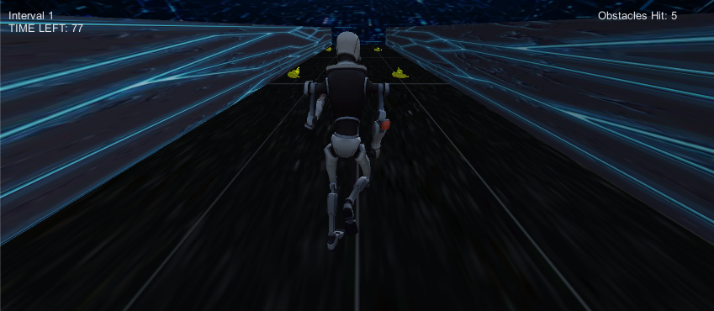
Robot Runner
Notes:
Exercise Requirements

Slide 24
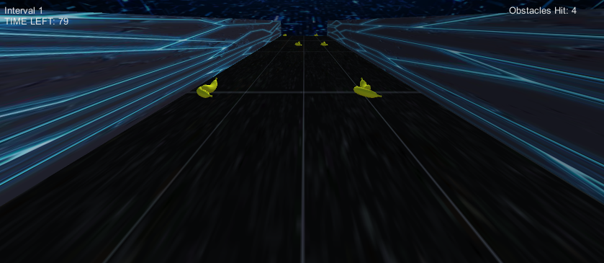
Robot Runner: Objective

Slide 25
Robot Runner: Indicators

Slide 26
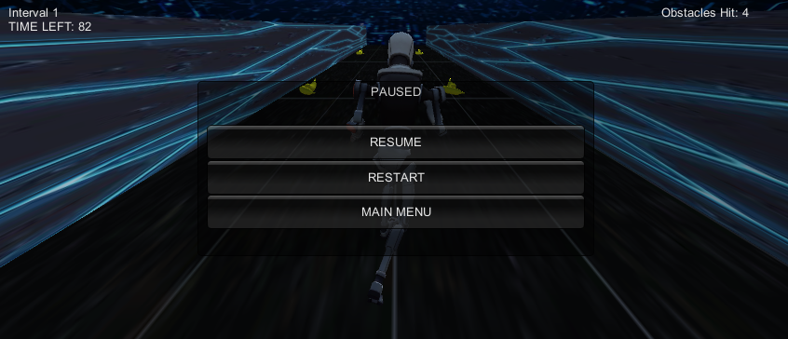
Robot Runner: Pause Screen

Slide 27
Robot Runner: Activity Complete

Slide 28
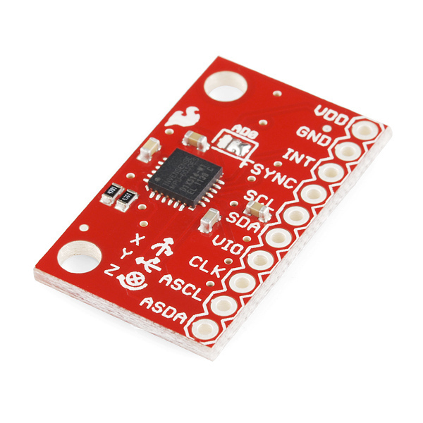
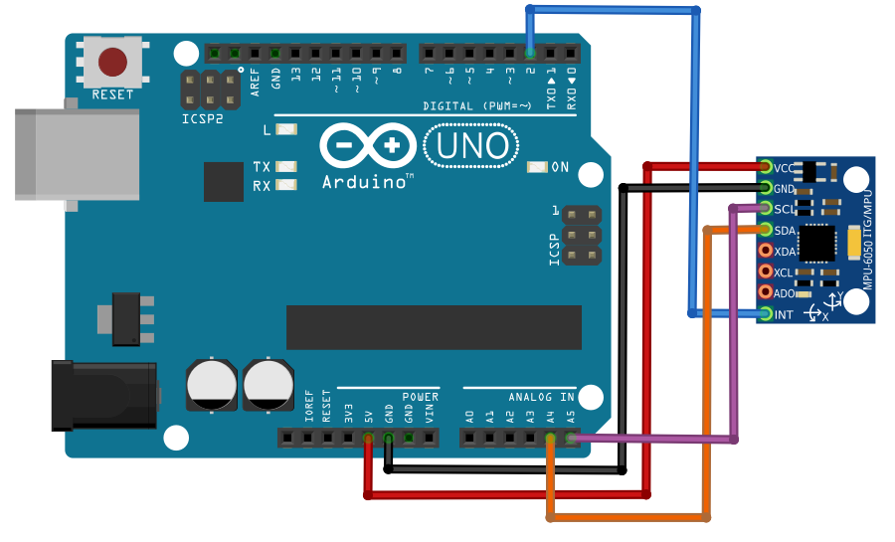
Accelerometer and Arduino
MPU-6050 Triple Axis Accelerometer and Gyro Breakout Sensor
Arduino Uno R3 USB Microcontroller
Notes:
Measures acceleration, angular velocity, and position

Slide 29
Future Directions & Overall Status

Slide 30
Robot Runner
Arduino
Final Prototype
Board
Notes:
Current Status

Slide 31
Robot Runner
Interface Component
Arduino
Final Prototype
Board
Notes:
Interface Requirements

Slide 32
Robot Runner
Interface Component
Arduino
Final Prototype
Board
Friction Brake
Flywheel

Slide 33
Robot Runner
Interface Component
Arduino
Final Prototype
Board
Mechanical Component
Friction Brake
Flywheel
Notes:
Adjustable Resistance

Slide 34
Robot Runner
Interface Component
Arduino
Final Prototype
Board
Mechanical Component
Friction Brake
Flywheel
Notes:
Recording Specifications
Reporting Specifications
Setup Steps

Slide 35
Robot Runner
Interface Component
Arduino
Final Prototype
Board
Mechanical Component
Friction Brake
Flywheel
Notes:
Safety
Cost of Materials
In summary we have all the separate components; and we now need to connect everything together!

Slide 36
Thank You!

